Slide 1
DESIGN AND IMPLEMENTATION OF A FOOD ORDERING SYSTEM (CASE STUDY AMAZI EATERY, FEDERAL POLYTECHNIC, MUBI) BY BASHERU USENI MUHAMMAD (ST/CS/HND/21/053) BEING A PROJECT PROPOSAL SUBMITTED TO THE DEPARTMENT OF COMPUTER SCIENCE, SCHOOL OF SCIENCE AND TECHNOLOGY, FEDERAL POLYTECHNIC, MUBI, ADAMAWA STATE. IN PARTIAL FULFILMENT OF THE REQUIREMENTS FOR THE AWARD OF HIGHER NATIONAL DIPLOMA (HND) IN COMPUTER SCIENCE. PROJECT SUPERVISOR: MR. YAYIRUS GARBA ULEA JULY, 2023

Slide 2
BACKGROUND TO THE STUDY
In today's fast-paced world, the food industry is undergoing a significant transformation, driven by advancements in technology and changing consumer preferences. Restaurants and eateries are increasingly adopting innovative solutions to improve operational efficiency, enhance customer experience, and stay competitive. One area of focus is the implementation of food ordering systems, which streamline the ordering process and enable seamless interaction between customers, restaurant staff, and kitchen operations. The food industry is constantly evolving, and technological advancements have significantly influenced the way restaurants and eateries operate. One area that has experienced notable transformation is the ordering process, with the introduction of food ordering systems.

Slide 3
PROBLEM STATEMENT
Amazi Eatery, a popular restaurant chain, has been facing challenges related to order management, customer satisfaction, and operational efficiency. The traditional manual ordering process has resulted in inefficiencies, order inaccuracies, and long waiting times, leading to customer dissatisfaction and potential revenue loss. To address these issues, there is a need for an effective food ordering system that can streamline operations, improve order accuracy, and enhance the overall dining experience.

Slide 4
AIM AND OBJECTIVES
The aim of this project is to design and implement a food ordering system at Amazi Eatery, focusing on the following specific objectives:
To identify the challenges faced by Amazi Eatery in its current order management process.
To design and develop a comprehensive food ordering system that caters to the specific needs of Amazi Eatery.
To design a secure system where order records of Amazi eatery can be kept and retrieved when needed.

Slide 5
DISADVANTAGES OF EXISTING SYSTEM
The manual system for food ordering, which typically involves handwritten order forms or verbal communication between customers and restaurant staff, has several disadvantages. These disadvantages highlight the need for an automated food ordering system like the one implemented at Amazi Eatery. Manual systems are prone to human errors such as misinterpreting handwritten orders, incorrect entry of order details, or miscommunication between staff members. These errors can lead to order inaccuracies, delays, and customer dissatisfaction.

Slide 6
ADVANTAGES OF PROPOSED SYSTEM
The following are the advantages of a Food ordering system. They include the following:
Increased Accuracy: Reduced human errors in order taking and processing.
Improved Efficiency: Streamlined order placement and processing, reducing waiting times.
Enhanced Order Tracking: Real-time order tracking for customers, improving transparency and engagement.
Centralized Information: Easy access to accurate and up-to-date information for customers and staff.
Enhanced Customer Convenience: Remote order placement, customization, and saved preferences for a seamless ordering experience.

Slide 7
PROPOSED METHOD
The user employed the use of a Waterfall Model of System Development Life Cycle in designing a website in implementing the system in order for it to be available at all times and accessible from any device. The researcher used two programming languages in the accomplishment of this system, they include: PHP for the database scripting side and MySQL for the database storage. They system also involves the use of HTML, CSS and Java Script codes for full functionality of the system.
The waterfall model was used to develop a new system. The six stages of waterfall model have been identified to achieved a complete design starting from requirements, analysis, design, coding, testing, and deployment. During the requirements stage, developers write down all the possible requirements of a system in a requirements document.

Slide 8
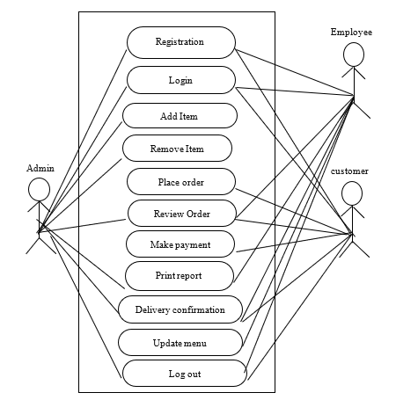
UML ALGORITHM
Use case diagram

Slide 9
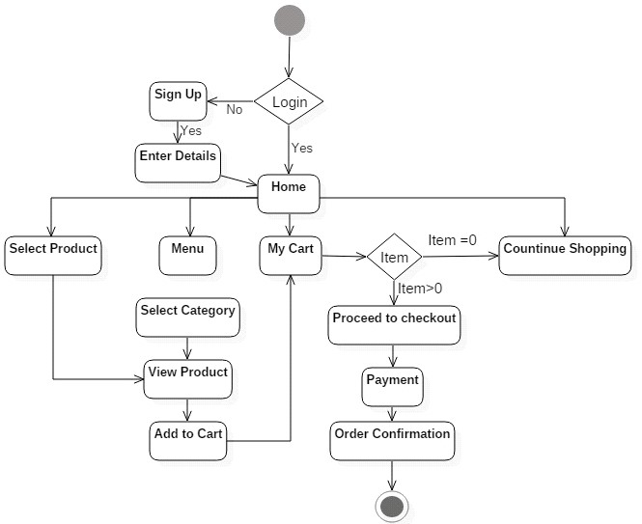
Activity diagram

Slide 10
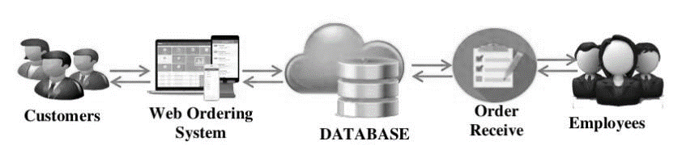
SYSTEM ARCHITECTURE

Slide 11
REFERENCES
Chen, H., Cai, D., & Zhou, H. (2018). What Determines Customer Satisfaction in Mobile Food Ordering Apps? Evidence from China. International Journal of Information Management, 43, 228-242.
Chen, H., Liu, Y., & Liu, J. (2020). Design and Implementation of a Web-Based Food Ordering System. In 2020 IEEE International Conference on Artificial Intelligence and Computer Applications (ICAICA), 21(1), 34-37.
Huang, Z., Li, Y., & Yu, Q. (2019). User Experience Design of Mobile Food Ordering System. In 2019 IEEE International Conference on Industrial Engineering and Engineering Management (IEEM), 5(1), 1610-1614.
Hwang, J., & Ryu, K. (2017). The Influence of Food Quality, Service Quality, and Price on Customer Satisfaction and Behavioral Intention in Quick-Casual Restaurants: Moderating Role of Perceived Hygiene Factors. Journal of Hospitality Marketing & Management, 26(8), 872-892.
Jang, J., & Namkung, Y. (2009). Perceived Quality, Emotions, and Behavioral Intentions: Application of an Extended Mehrabian-Russell Model to Restaurants. Journal of Business Research, 62(4), 451-460.

Slide 12
THANKS FOR LISTENING

